Slide 1
LMS User Guide
Rachel Crossan
L&D Digital Lead

Slide 2
Agenda
How to access your training plan | Training Platform Landing page | Navigate the Training Platform | Register for your Curriculum | How to Launch your First Module
Final Assessments | Curriculum completion | Account preferences & Accessibility | Using your personal device | Manual login process

Slide 3
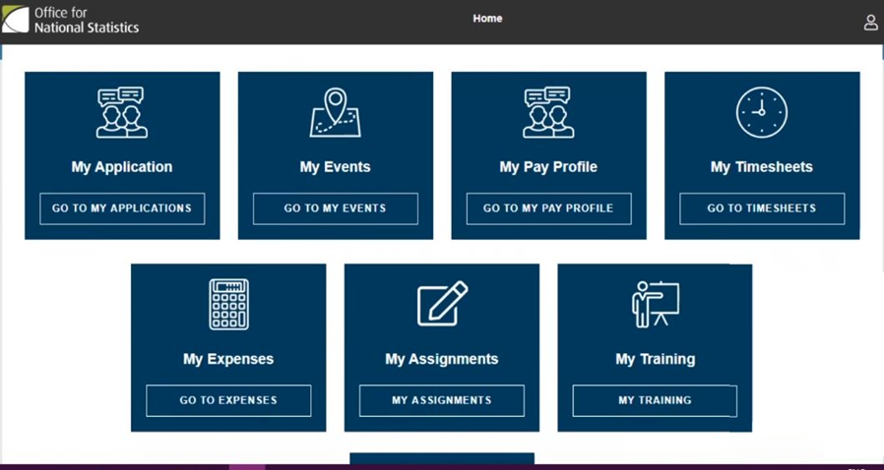
How to access your training plan
On Day 1 of Induction Week you’ll receive an email on your Connect Portal with your login details to Salesforce Connect.
Log into Salesforce Connect, then from the Home Menu, once your Learning Profile has been successfully activated, you will see the “My Training” button in the lower right of the screen.
Click upon “My Training”.
The system will automatically log you into the training platform (LMS) within the browser window.

Slide 4
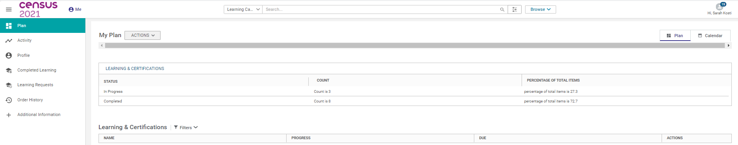
Training Platform landing page
On the “My Plan” landing page below, you will be able to start your assigned Training Plan, which consists of several learning activities that are relevant to your role.

Slide 5
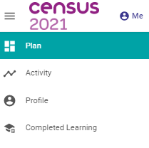
Navigate the training platform
On the left hand side you will see the available menu options which are shortcuts to the pages that will be useful to you.
These include:
My Plan: here you can see your assigned learning activities and progress
Profile: check here to ensure your account information is accurate
Completed Learning: here you can revisit any of your completed training modules
at any time throughout your employment
If at any time you are unable to access the Training Platform, or experience any difficulties, please email the helpdesk team on: onshelpdesk@adecco.co.uk
or call them on 0800 085 8239.

Slide 6
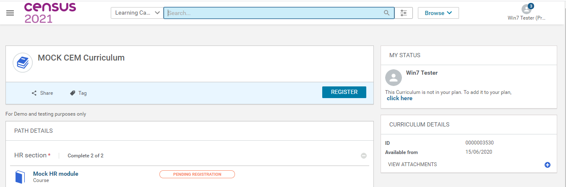
Register for your curriculum
Upon entry to the SABA LMS, the system will prompt you to Register for your Curriculum.
This is performed by clicking upon the [Register] button.

Slide 7
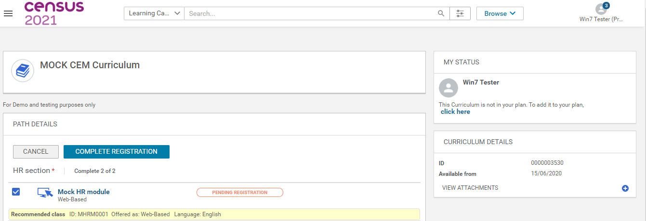
Registration continued…
Next click the [Complete Registration] button
Until this is performed, the content will not be accessible and the [Launch] button will not be active/visible

Slide 8
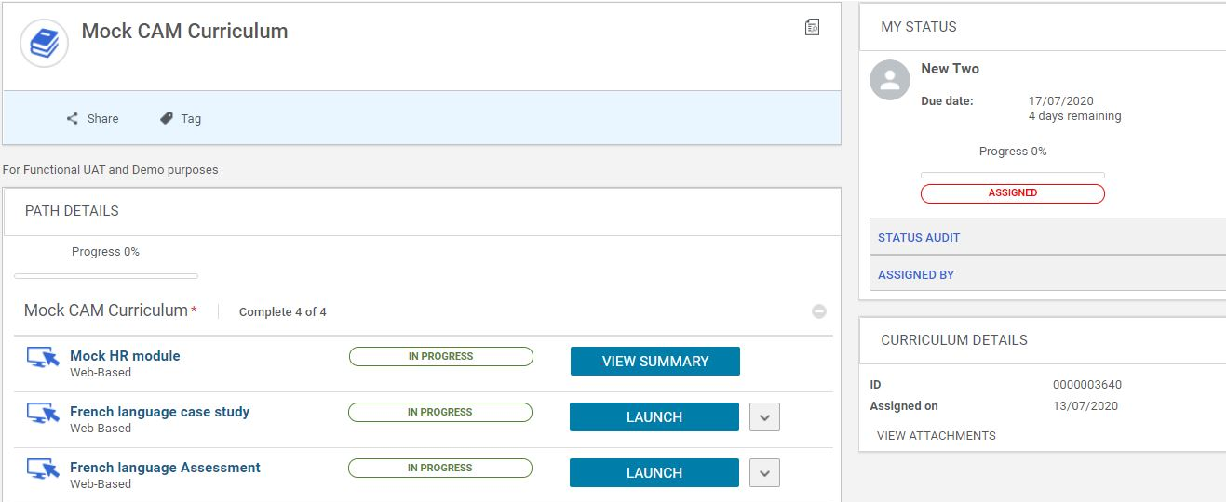
How to launch your first module
On the “My Plan” landing page, under “Learning and Certifications”
Scroll down and either select the title of the first module listed within your curriculum or click upon the Launch button
The modules are presented and to be completed in sequential order, you must pass each modules assessment before you can move on

Slide 9
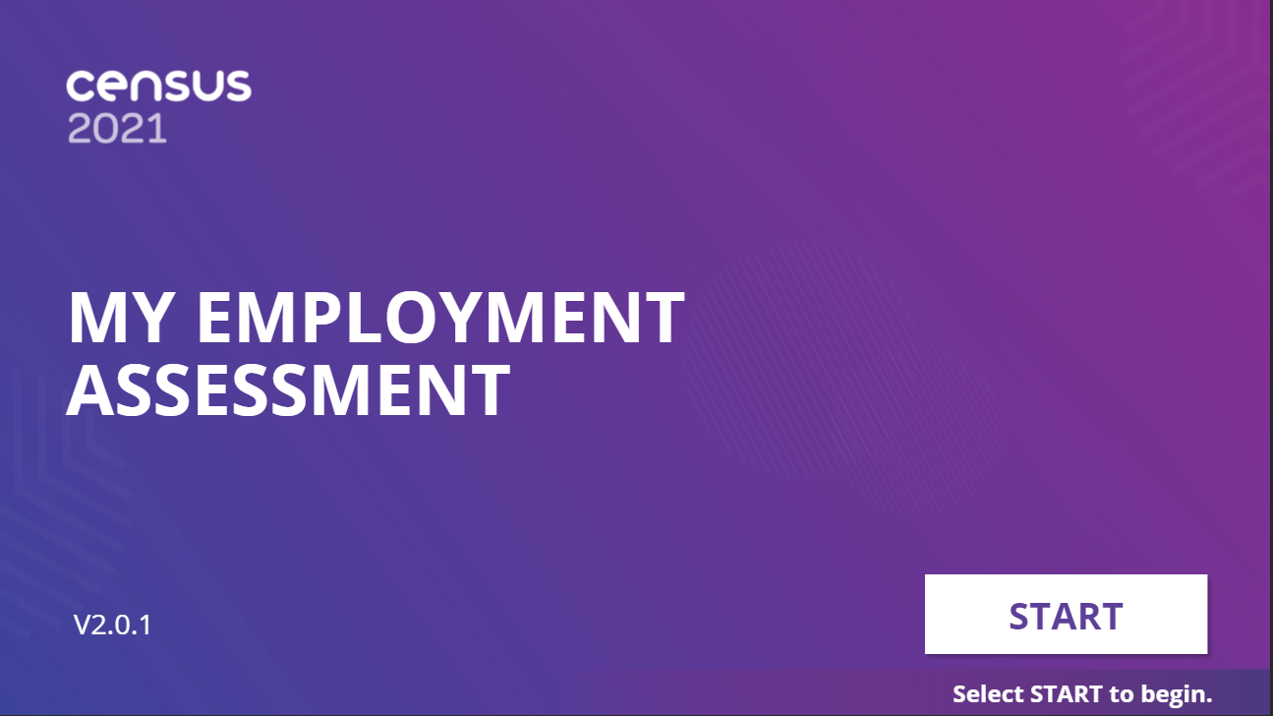
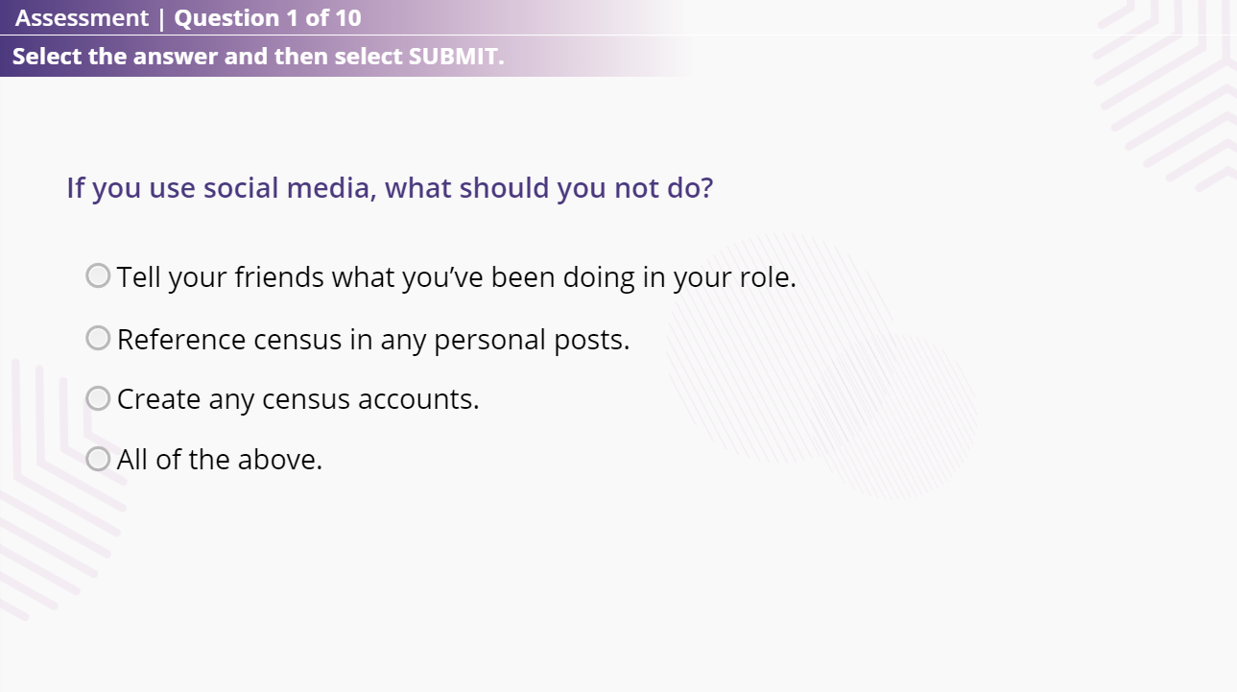
Final Assessments
At the end of each module there will be a final assessment with a minimum pass rate of 80%
You will have 3 attempts to successfully complete each one.

Slide 10
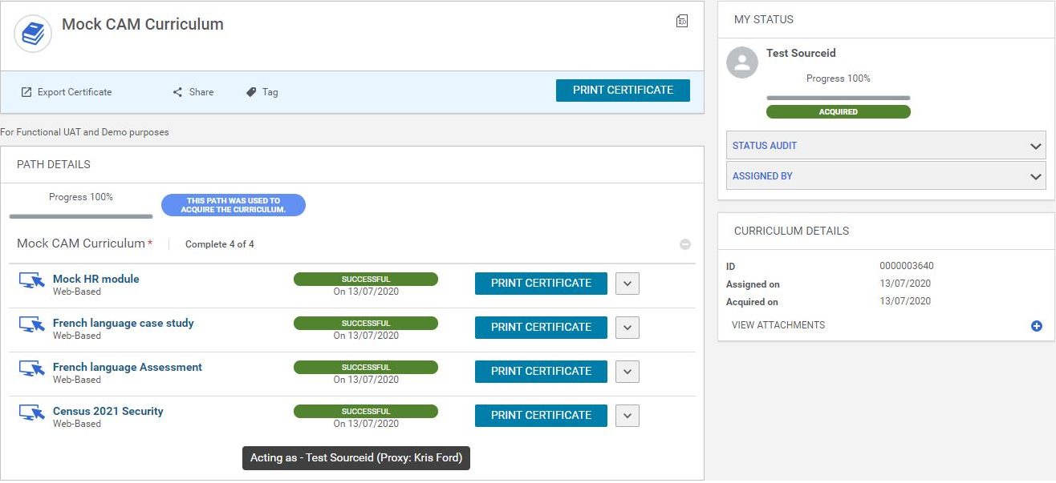
Curriculum completion
As you complete a module, the status will change to Successful. You must complete all modules within your curriculum.
You will have access to revisit all training modules during your employment.

Slide 11
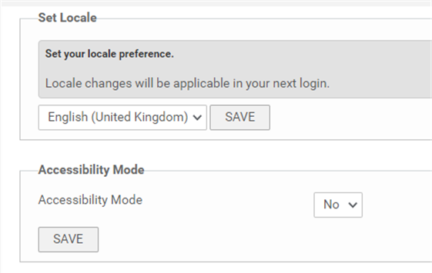
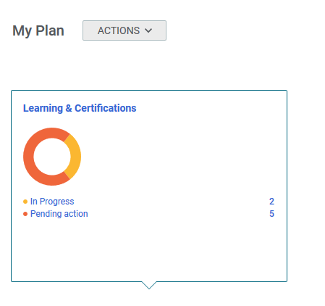
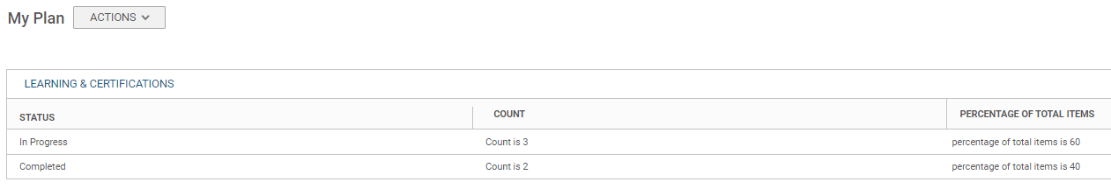
Account preferences
Accessibility Off
Accessibility Mode is set to Yes as standard to change this:
Go to the ‘Hi, my name’ menu at the top right of the screen.
From the drop-down list, click on Account Preferences.
When the window refreshes the available options are displayed.
Click on the Accessibility Mode drop down menu and select ‘No’
Click on the Save button.
Accessibility On

Slide 12
Using your personal device
If you choose to access your training via a personal device then you can do so.
If using a phone then you’ll need to install the relevant App link below:
Android App on phone: https://play.google.com/store/apps/details?id=com.cisco.webex.meetings
iOS App on phone: https://apps.apple.com/us/app/cisco-webex-meetings/id298844386
If using a laptop then you will need to install the relevant browser add on below:
Cisco WebEx for Chrome via laptop:
https://chrome.google.com/webstore/detail/cisco-webex-extension/jlhmfgmfgeifomenelglieieghnjghma?hl=en
WebEx for Firefox via laptop:
https://addons.mozilla.org/en-US/firefox/addon/cisco-webex-extension/

Slide 13
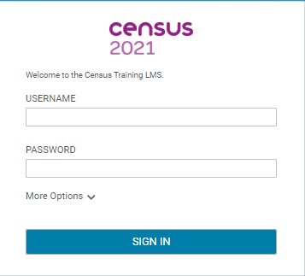
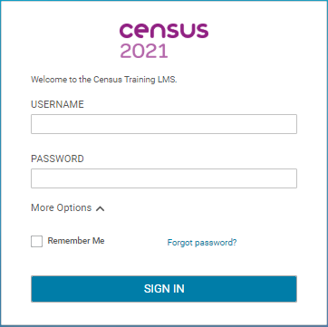
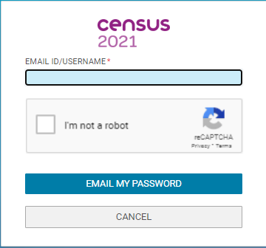
Manual login process
If for any reason you are unable to access the Saba LMS via Connect then you can manually login:
Within the web browser address bar type: www.censustraining.co.uk and press enter.
On the login screen, use your work email address: ‘…@ons.gov.uk’ which is also your username.
The default password will be set s ‘#********’. You will be prompted to change it to something more secure on first sign in.
What to do if you forget your password
If you forget your password, you can use the Forgotten Password option:
Click on ‘More Options’ to expand the dialogue box and select the
‘Forgotten your Password’ link.
Enter your valid ONS email address and click on the ‘I’m not a robot’ check box.
Once you select the ‘EMAIL MY PASSWORD’ button, an email will be sent to your inbox containing a link which will allow you to change the password.

